Slide 1
Climate Change Belief Analysis 2022
ML Corps
Innovations designed for creating a better world

Slide 2


Get to Know the Team
Company Name:
ML Corp - Innovations designed for creating a better world
Team members:
Mandlenkosi Ngidi
Lungile Makondo
Mike Ngwenya
Mxolisi Aubrey

Slide 3

Understanding the problem
Many companies are looking to redcue their company’s carbon footprint
Therefore products and services that are environmental friendly and sustainable are offered by these companies
A company would like to then know people’s thoughts on climate change and whether people/customers believe it is a real threat or not
The gathered information will add to the marcket research efforts into gauging how the products and services may be interpreted by the public

Slide 4

Project objective
Create a model that will classify a person’s belief in climate change based on the person’s novel tweet data
An accurate and robust solution gathered from the analysis will give access to a broad base of consumer sentiment, spanning multiple demographic and geographic categories. This will increase insight and inform future marketing strategies

Slide 5
Exploratory Data Analysis (EDA)
1
2
Features
3 columns
Sentiment
Message
TweetID
15819 rows
Observations
3
2 – News
1 – Pro
0 – Neutral
-1 – Anti
Sentiment Types

Slide 6
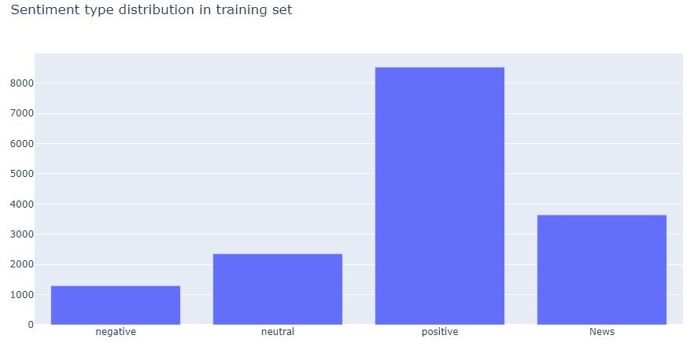
Exploratory Data Analysis (EDA)
The data is imbalanced where there are more tweets that are positive (more tweets that suggest people believe in climate change) than the other classes. This means that the model will efficiently predict positive tweets more than the other classes.

Slide 7
Data Preprocessing and Data Engineering
Data Cleaning
1
Stopwords such as 'a', 'the', 'and’, etc. were removed
Tokenization
2
Words in a sentences were split into individual words and tokenized
Lametization
3
Words were stemmed to their root form (eg: ‘computation’ was stemmed to ‘compute’)
Removing Repitition
4
Duplicated words were removed from the datasets

Slide 8
Machine Learning Algorithms
Logistic Regression
K-Nearest Means
Decision Tree
RBF Support Vector Machine (SVM)

Slide 9
Model Performance & Model Evaluation
The model performance is measured and evaluated
Decision tree model
RBF SVM
Logistic Regression
K-Nearest Means
Accuracy | 0.9874
Accuracy | 0.9987
Accuracy | 0.6565
Accuracy | 0.5354
Precision | 0.9892
Precision | 0.9986
Precision | 0.7084
Precision | 0.1338
Recall | 0.9841
Recall | 0.9985
Recall | 0.4659
Recall | 0.2500
F1 Score | 0.6565
F1 Score | 0.5486
F1 Score | 0.4385
F1 Score | 0.1784

Slide 10
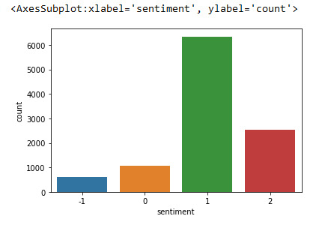
Model Predictions
Logistic Regression model

Slide 11
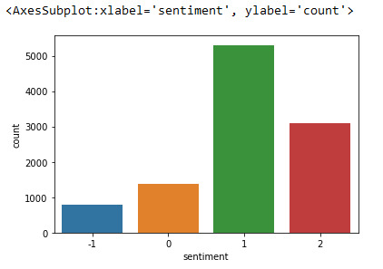
Model Predictions
K-Nearest Neighbor model

Slide 12
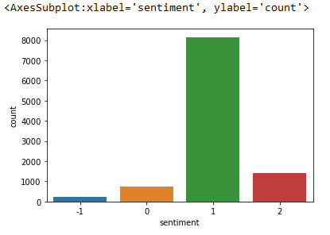
Model Predictions
Decision Tree model

Slide 13
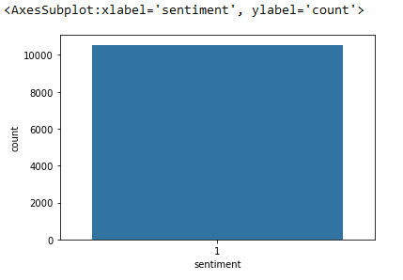
Model Predictions
Support Vector Machine (SVM)

Slide 14

The Chosen Model
Our chosen model is the Logistic Regression model.
Reason being:
Produced the best F1 Test Score
Produced the best score on the Kaggle competition of 0.72

Slide 15
Streamlit App
The trained models were deployed to the Streamlit App that we created so that the client can have access to it for future use.

Slide 16

Thank You!

